Slide 1
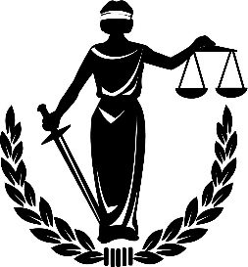
Ch. 5 Law Test Review

Slide 2
1. Jurisdiction is the power and
__________ given to a court to hear a case and to make a judgment.
authority

Slide 3
2. Admiralty pertains to the _____________.
sea

Slide 4
3. The Court of Appeals has _____________ jurisdiction.
appellate

Slide 5
4. There are approximately ______ District Courts in the United States.
95

Slide 6
5. The ________ Court is the highest court in the land.
supreme

Slide 7
6. _______________ jurisdiction is the Supreme Court’s main function.
Appellate

Slide 8
7. Federal Courts are arranged in ________ steps or tiers.
3

Slide 9
8. _____________ jurisdiction is the authority to hear cases on appeal.
appellate

Slide 10
9. Each state has a minimum of ________ District Court(s).
1

Slide 11
10. The _______________ Court has both appellate and original jurisdiction.
supreme

Slide 12
11. Most Court of Appeals Cases have _______ Judges.
3

Slide 13
12. ___________ US Courts only have jurisdiction in specialized kinds of cases.
special

Slide 14
13. District Courts have ____________ jurisdiction.
original

Slide 15
14/15 Only questions of _________ can be raised, not questions of _________ under the Court of Appeals.
Law
Fact

Slide 16
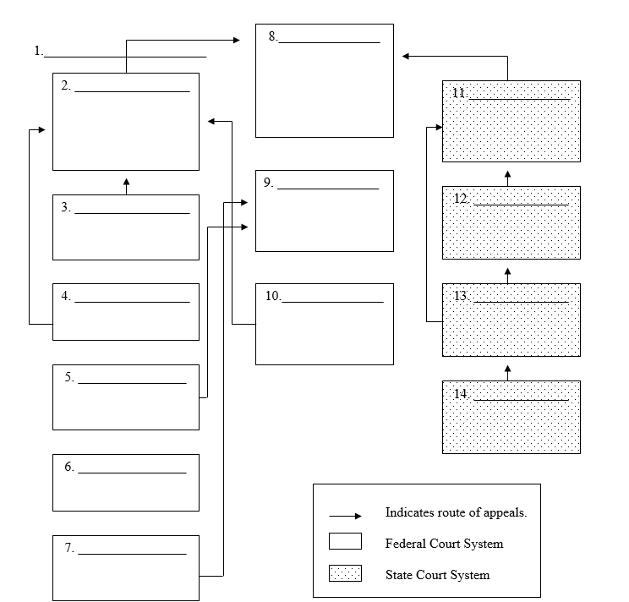
US Supreme Court
Special US Courts
Court of Appeals for the Federal Circuit
State Supreme Court
Intermediate Appellate Court
US Claims Court
Appellate Court
US Court of International Trade
US District Court
General Trial Court
US Tax Court
Lower Trial Court
US Territorial Courts
US Court of Military Appeals

Slide 17
Intermediate courts are also called
Appellate Courts

Slide 18
Actions involving more than $50,000 between citizens of different states are known as _______________________ cases.
diversity of citizenship

Slide 19
Courts that hear cases concerning young people are ________ courts.
juvenile

Slide 20
Because the U.S. courts of appeals have authority to hear appeals from lower courts, we say they have ______________________.
appellate jurisdiction

Slide 21
Because their authority extends only to minor matters, local courts are called courts of _________________.
limited jurisdiction

Slide 22
The power and authority given to a court to hear a case and to make a judgment is called _____________.
jurisdiction

Slide 23
Trial courts that handle cases involving major crimes and large amounts of money are called courts of ___________________.
general jurisdiction

Slide 24
______________ courts hear civil cases involving a limited amount of money.
Small claims (local)

Slide 25
Courts that are between the lower courts and the highest court are called __________________ .
intermediate courts

Slide 26
A court that has authority to try a case the first time it is heard is known as a court of _____________________.
original jurisdiction

Slide 27
The federal court system derives its power from
The US Constitution

Slide 28
Local courts are courts of
limited jurisdiction.

Slide 29
Intermediate courts hear appeals on
The Law ONLY.

Slide 30
The function of the highest court is to make the final determination
on matters of the law.

Slide 31
The US Supreme Court has
BOTH original and
appellate jurisdiction.

Slide 32
The ___________ courts have jurisdiction over admiralty and bankruptcy cases.
Federal

Slide 33
Most US Court of appeal cases are decided by a panel of ___ judges.
3

Slide 34
The US Supreme Court
______ decide which cases it will hear from the lower courts.
does

Slide 35
The _____________________ are the major trial courts in each state.
Courts of General Jurisdiction

Slide 36
Jurisdiction of ___________ is set by state statute.
Juvenile Courts

Slide 37
Carter Newton, a resident of Indiana, was arrested for speeding while driving in Kentucky. When brought before the local traffic court, he claimed that the court had no jurisdiction over him since he was an out-of-state resident. Is his contention correct?
No, people must obey the law no matter where they are.

Slide 38
Susan Bond and Bob Cox were residents of the same large city. Bond contended that she could sue Cox in appellate court to collect $75 owed to her by Cox. Is Bond correct?
NO, Small Claims Courts

Slide 39
Anita Lawson has a civil case coming up at the local justice of the peace court. Bonnie Knox told Anita that she would see her in court because her criminal case was being tried in the same court on the same day. Lawson did not believe Knox because she thinks that justice of the peace courts do not hear both criminal and civil cases. Is Lawson correct?
Justice of the Peace Courts hear both Criminal and Civil cases without a jury.

Slide 40
Carmella Martinez, who owns a dress shop, is about to go into bankruptcy. She had heard that she could do this by filing some papers in court. She took her books, showing how much she is in debt, to the municipal court. Will that court accept her bankruptcy claim?
No, Federal Court has exclusive jurisdiction over bankruptcy cases.

Slide 41
Paul Blackmore was 16 years and 10 months old when he and some older friends broke into a supermarket at night and stole an automatic teller machine. He was arrested for the crime when he was 18 years old. Will his case be heard in juvenile court?
Juvenile court has jurisdiction of persons under the age of 18

